Slide 1
Nimble Cybersecurity Incident Management through Visualization and Defensible Recommendations
Jamie Rasmussen, IBM Research
14 September 2010
VizSec 2010

Slide 2
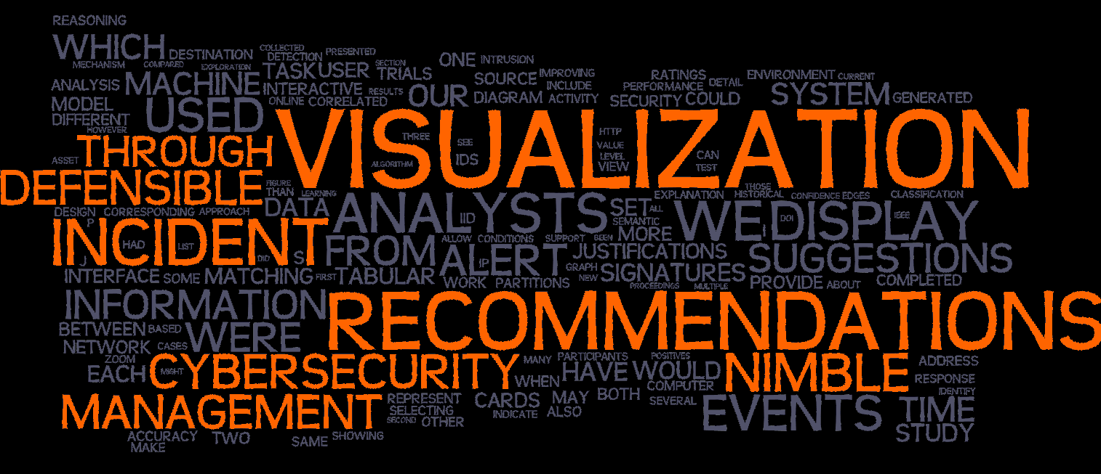
Nimble Cybersecurity Incident Management through Visualization and Defensible Recommendations
Jamie Rasmussen, IBM Research
14 September 2010
VizSec 2010

Slide 3
Our Goal
Help online analysts in Security Operations Centers complete their tasks more quickly and accurately

Slide 4
Our Approach
An interactive graph-based visualization of correlated IDS output
Defensible recommendations based on machine learning from historical analyst behavior
Prototype tested with professional analysts in a controlled study

Slide 5
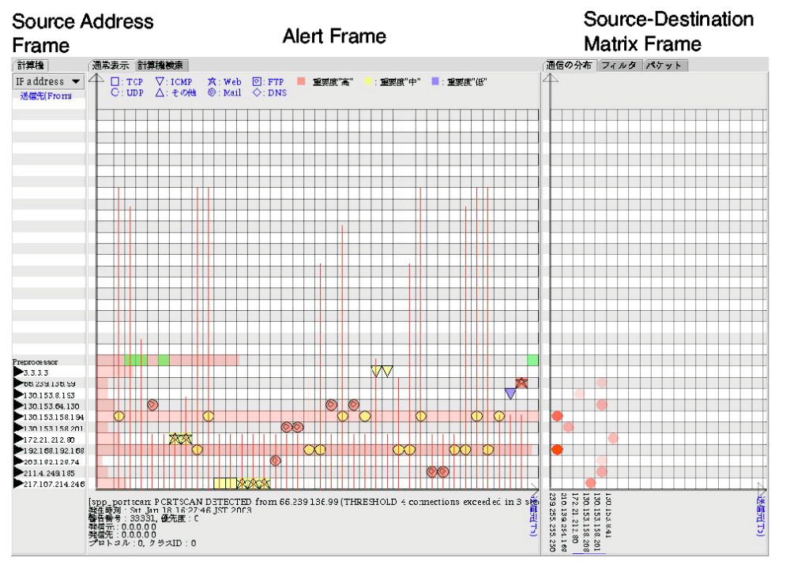
SnortView
Related Work: IDS Alert Visualization
Hideki Koike and Kazuhiro Ohno, VizSec 2004

Slide 6
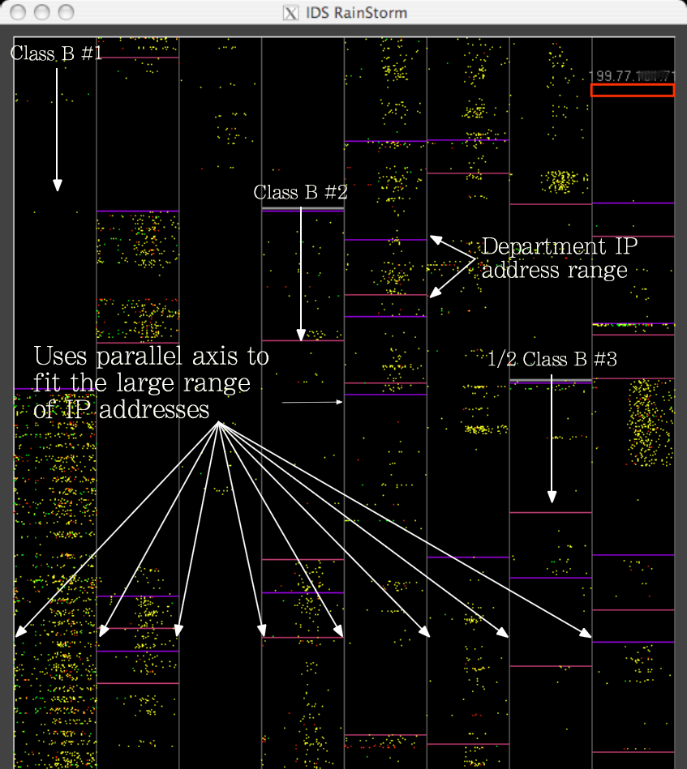
IDS RainStorm
Related Work: IDS Alert Visualization
Kulsoom Abdullah et al., VizSec 2005

Slide 7
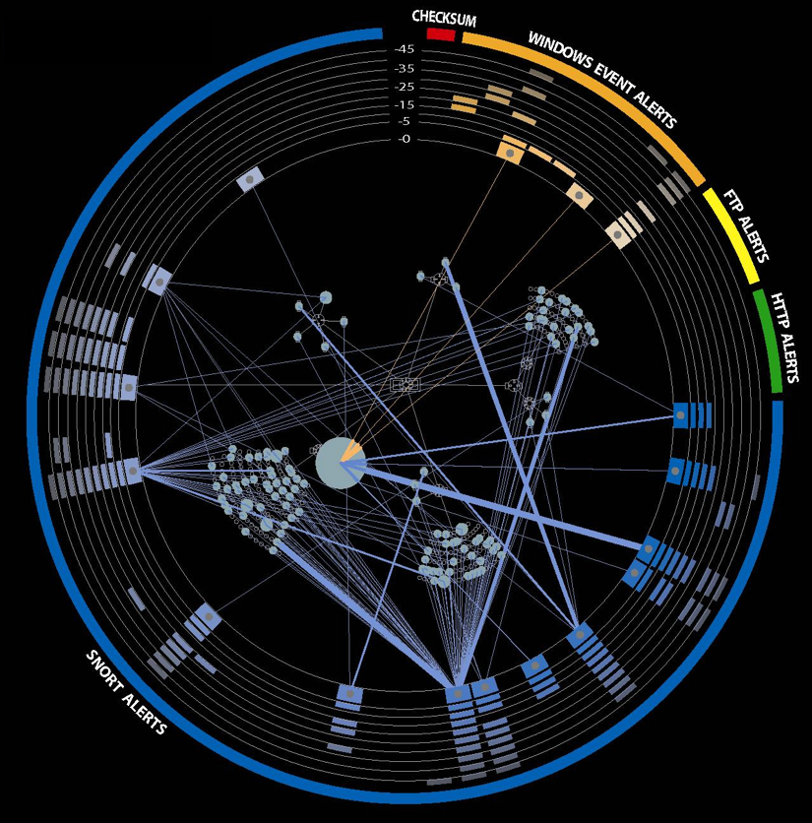
VisAlert
Related Work: IDS Alert Visualization
Yarden Livnat et al., 2005

Slide 8
Data Collection and Preparation
3 Monitored Organizations
8 Days
7 Sensors
2,869,108 IDS Events
164 Alerts
29 Analysts
106 Machines with Asset Information
No Identifying Information
  No plain text fields collected
  IP addresses anonymized using Crypto-PAn
  All unique identifiers replaced

Slide 9
Event Clustering
3x B
1.1.1.3
C
1.1.1.6
B
A
1.1.1.1
2x A
1.1.1.2
X
B
1.1.1.4
A
2x B
B
1.1.1.5
Source | Signature | Destination
1.1.1.1 | A | 1.1.1.2
1.1.1.1 | A | 1.1.1.2
1.1.1.2 | B | 1.1.1.3
1.1.1.2 | B | 1.1.1.4
1.1.1.2 | B | 1.1.1.5
1.1.1.3 | C | 1.1.1.6
Partition 1
Partition 2
Partition 3
Partition 4
In each partition, each source must be connected
with each destination by each signature at least once

Slide 10
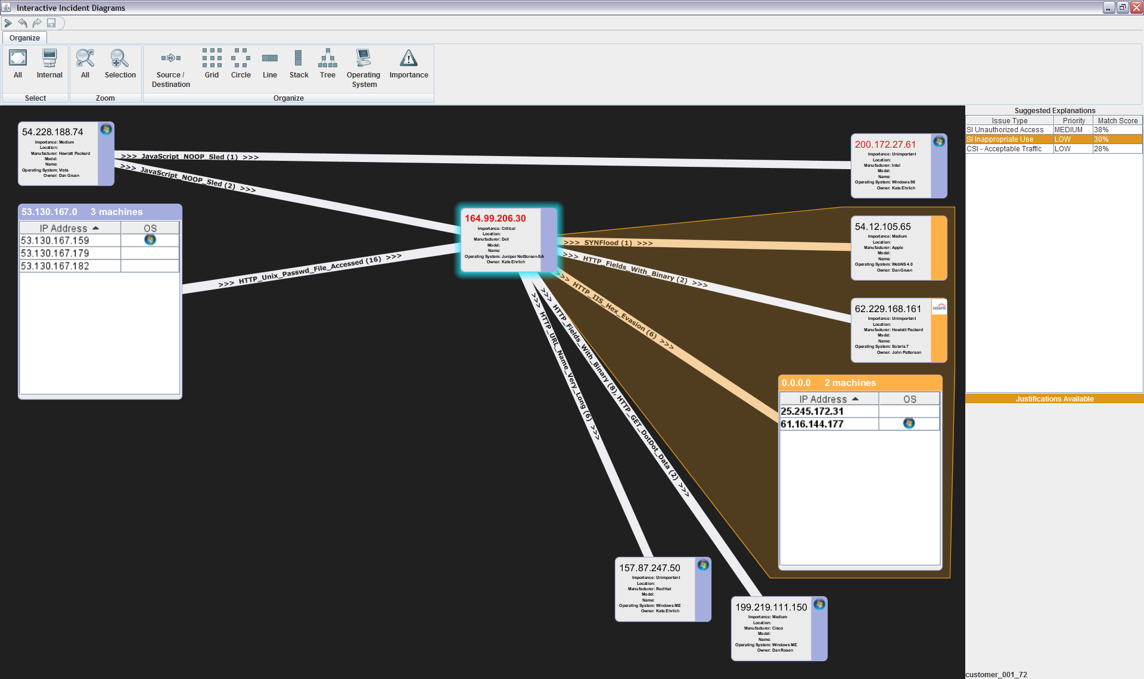
Interactive Incident Diagram (IID)
Each partition is rendered as a single arc, labeled with event signatures and counts
Sources and destinations are rendered as nodes
Multiple sources or destinations in a partition are rendered as a table
Visualization graphs can be manipulated, rearranged, zoomed, and explored

Slide 11
Research Questions
Is diagnosis better with this interactive visualization than a tabular display?
Will analysts benefit from the display of classification recommendations?
Will the benefits depend on whether the recommendations are accompanied by justifications?

Slide 12
The Study
Participants
  18 professional security analysts
  Minimum of three years experience, most had over five
Each participant completes 24 trials. For each trial:
  Analyst presented information about an alert
  Asked to classify it with regards to issue type and priority
  Two minute time limit with audible warnings
  Once they have classified it indicate their confidence in their judgment
  “Talk-Aloud” protocol
After trials, participants completed a survey
Discussion with all participants in a group debrief session
Notes:
Fully balanced design
2 x 3 x 2 x 2 = 24

Slide 13
The Study
Four experimental conditions
  Presentation of Events: Visual or Tabular
  Recommendation: No Suggestions, 3 Suggestions, or 3 Suggestions with Justifications
  Correct Suggestion Available: Yes or No
  Block of Trials: First or Second
Measurements
  Accuracy of response
  Time to complete problem
  Confidence in response
  Ratings from survey
Notes:
Fully balanced design
2 x 3 x 2 x 2 = 24

Slide 14
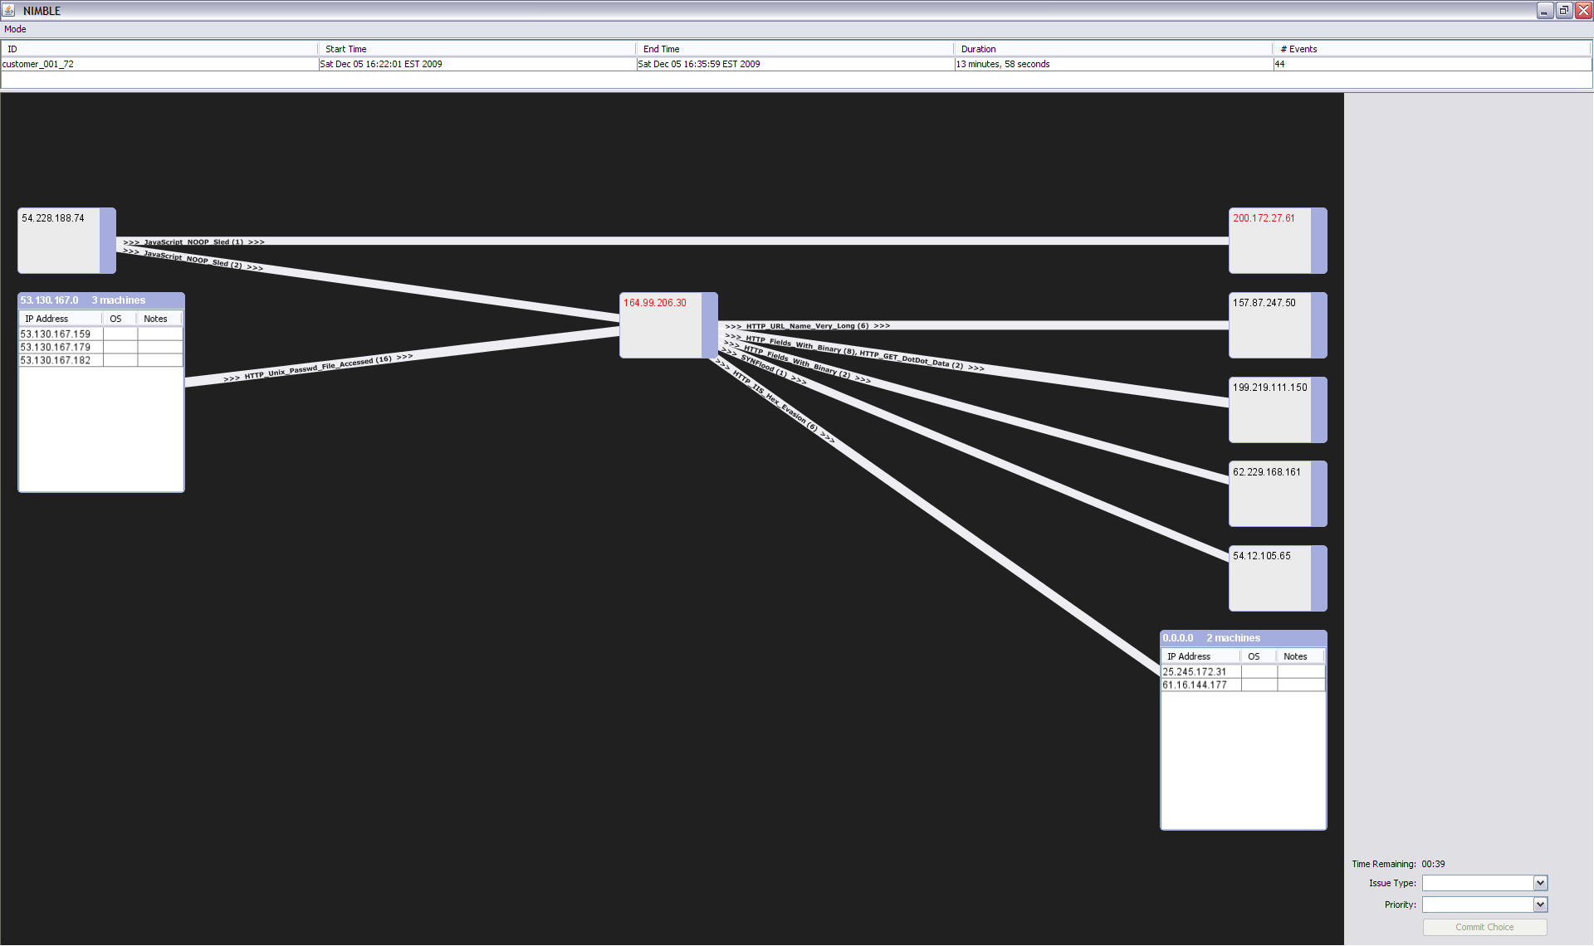
Visual Display

Slide 15
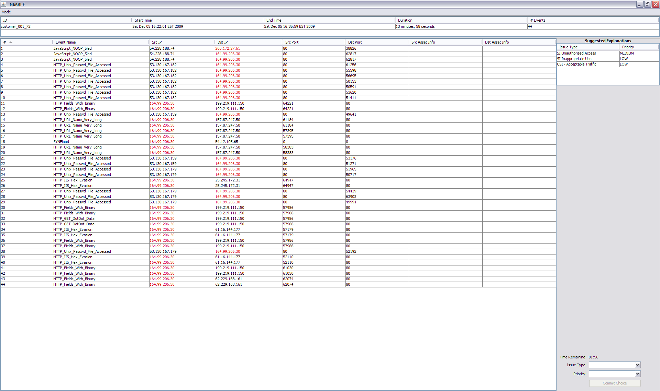
Tabular Display with Suggestion

Slide 16
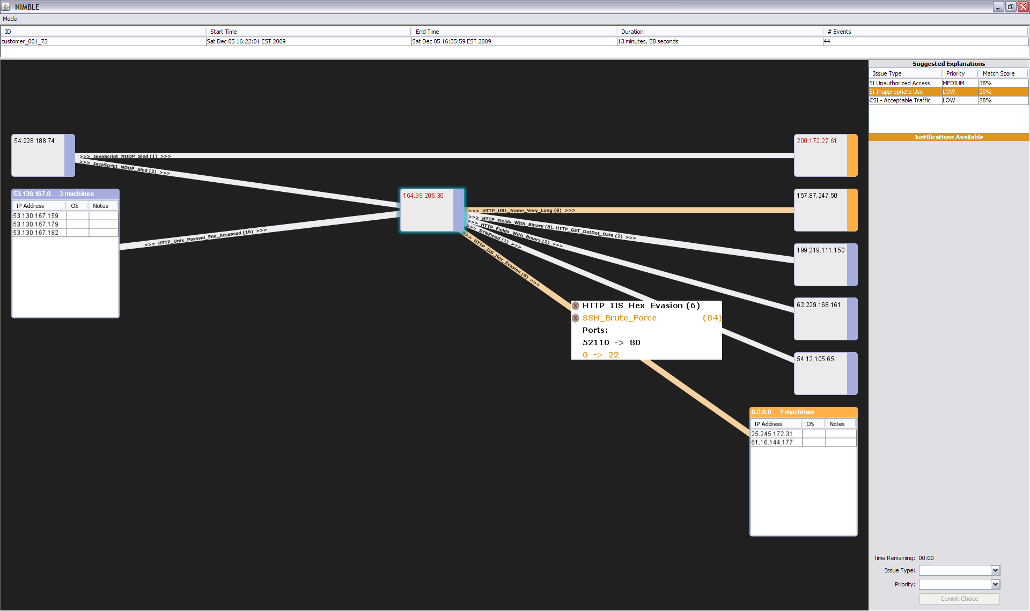
Visual Display with Justification

Slide 17
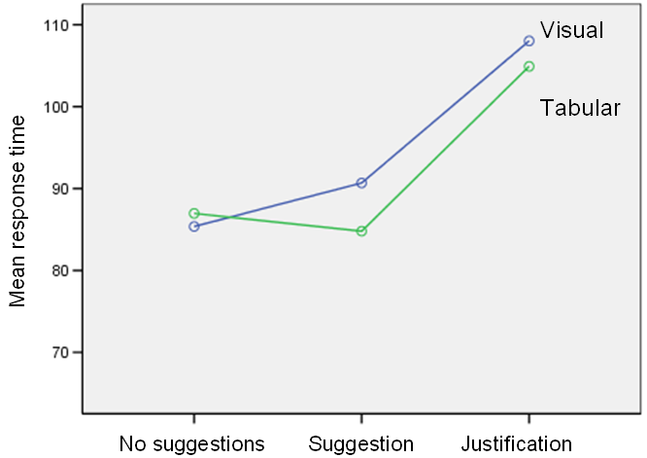
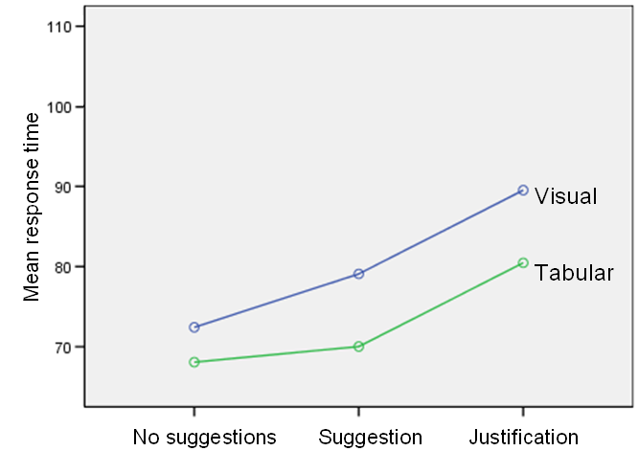
Response Time Across Display and Recommendation Conditions
Study Results
First set (seconds)
Second set (seconds)
First set took longer overall than second set (p < 0.01)
Justifications and suggestions took longer than baseline (p < 0.01)
Visual displays took slightly longer than the tabular displays (p = 0.12)
Notes:
Training effect – they got faster on the second set (not unexpected)
Visual came out slower than tabular, which may be attributable to the relative unfamiliarity combined with the talk-aloud protocol.

Slide 18
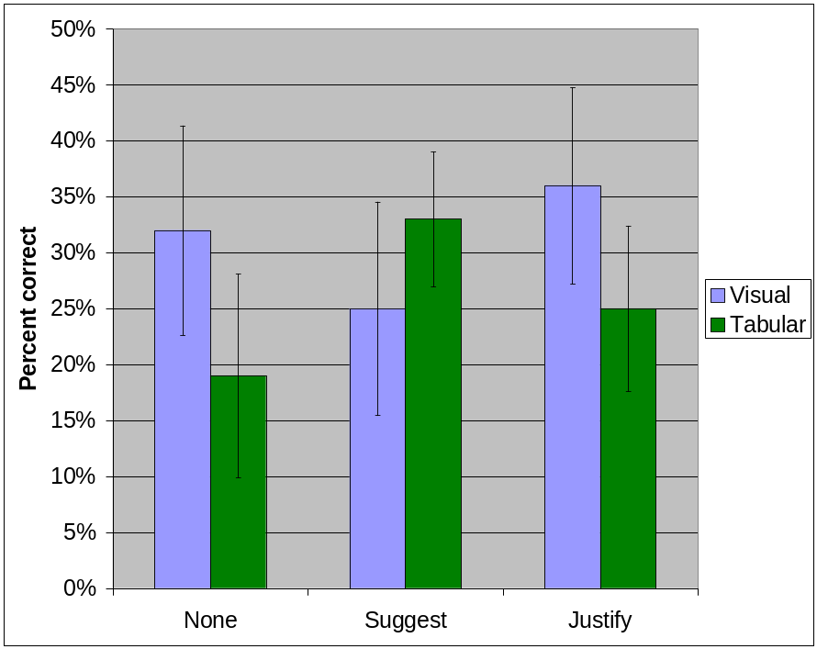
Accuracy Across Display and Recommendation Conditions
Study Results
Slightly higher accuracy associated with visual (31%) than tabular (26%) across all recommendation conditions (p < 0.10)
Effect stronger in second half, accuracy with visual was 35%, tabular was 20% (p < 0.05)
Across both display types, there was no overall difference between the three level of recommendation (p > 0.10)
Notes:
Study did a within-subject anova, basic lesson, we got marginally higher accuracy with visual than tabular. And justifications improved visual accuracy further
Now the accuracy seems pretty low, but that’s not a reflection on the analysts we tested
Increased “noise”
Reduced information. Absence of asset and other information
Anonymization stripped off additional information
Task
Task required more explicit determination of issue type than usual
Response variables
Accuracy. Measured against historical data where more information available
Number of incorrect recommendations decreased confidence
Response time. “Talk aloud” increases response time and variability

Slide 19
Research Questions Revisited
Is diagnosis better with this interactive visualization than a tabular display?
  Analysts were more accurate with the visualization, slightly slower
  Two “camps”, strong proponents for both kinds of display
Will analysts benefit from the display of classification recommendations?
  Analysts were slower when recommendations shown, no impact on accuracy
  The prevalence of incorrect recommendations may have reduced utility
Will the benefits depend on whether the recommendations are accompanied by justifications?
  Individual ratings for justifications significantly higher than for suggestions
  Preference for justifications increased with tenure

Slide 20






Thank You!
Jamie Rasmussen
Software Engineer
jrasmus@us.ibm.com
Kate Ehrlich
Research Scientist
katee@us.ibm.com
Steven Ross
Technical Lead
Steven_Ross@us.ibm.com
Susanna Kirk
Student Intern
sekirk@us.ibm.com
Dan Gruen
Research Scientist
Daniel_Gruen@us.ibm.com
John Patterson
Manager & Distinguished Engineer
John_Patterson@us.ibm.com

